Slide 1
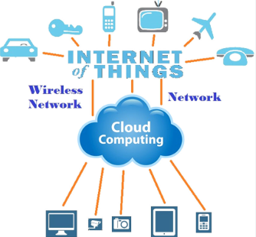
IOT AND CLOUD COMPUTING
By,
Ass. Prof. Kunal D Gaikwad
Pursuing PHD (IOT and Machine Learning)
M.E(Computer Networks)
B.E(Computer Science & Engineering)
Diploma(Computer Engineering)
Ass. Prof. Kunal D Gaikwad
CSE Department, CMRIT

Slide 2
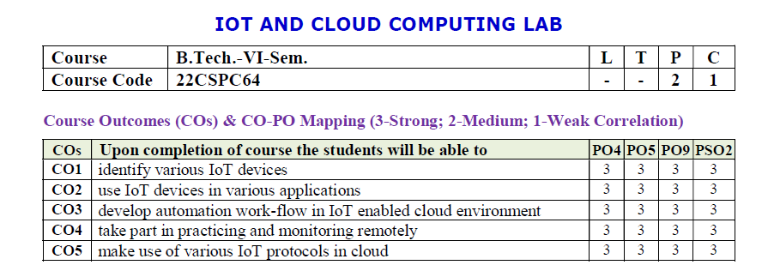
Ass. Prof. Kunal D Gaikwad
CSE Department, CMRIT

Slide 3
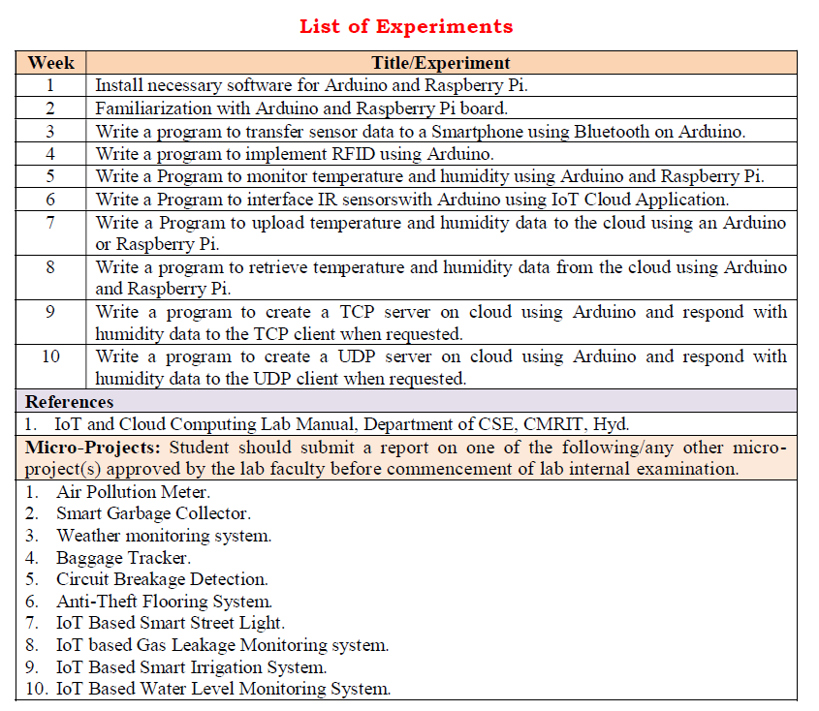
Ass. Prof. Kunal D Gaikwad
CSE Department, CMRIT

Slide 4
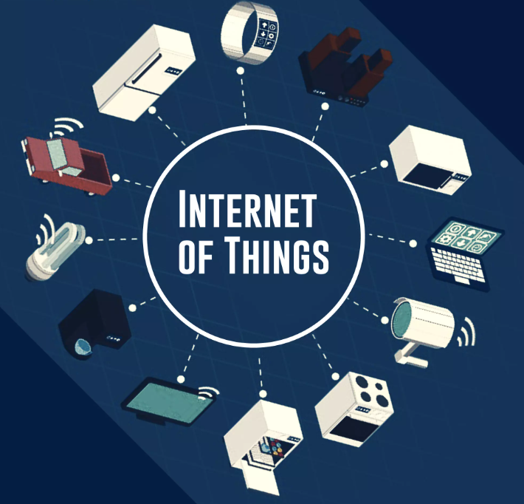
1. Introduction to Internet of Things
Definition: The Internet of Things (IoT) refers to a network of physical objects—devices, vehicles, appliances, and other items embedded with sensors, software, and connectivity to exchange data over the internet.
Some common examples of things or devices
mobile phones
Home automation digital voice Assistants
computer/Laptops
Arduino/Raspberry pi
Robot
Ass. Prof. Kunal D Gaikwad
CSE Department, CMRIT

Slide 5
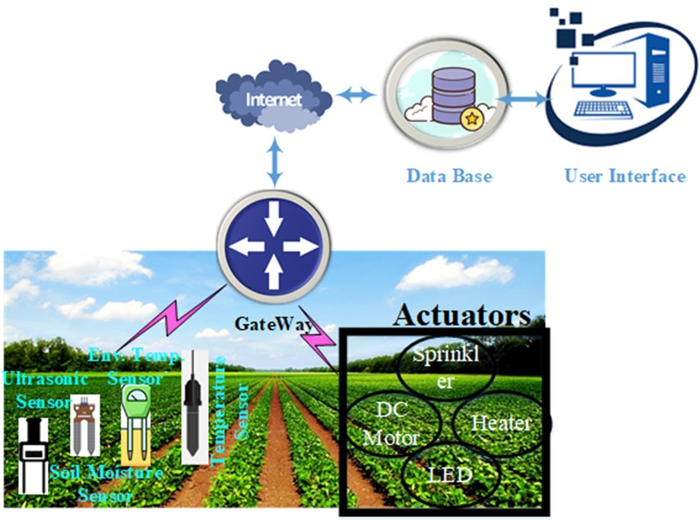
Week 1
Ass. Prof. Kunal D Gaikwad
CSE Department, CMRIT

Slide 6
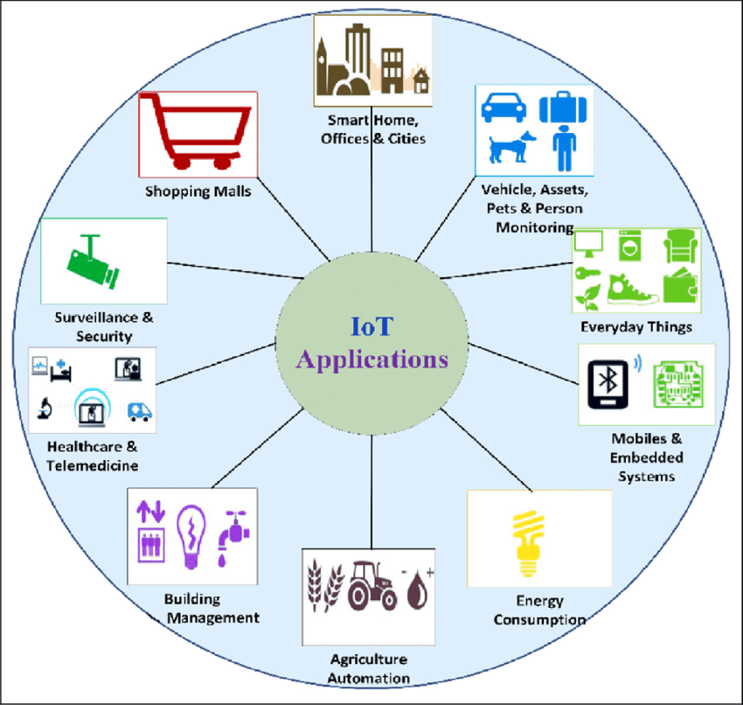
Week 1
Ass. Prof. Kunal D Gaikwad
CSE Department, CMRIT

Slide 7
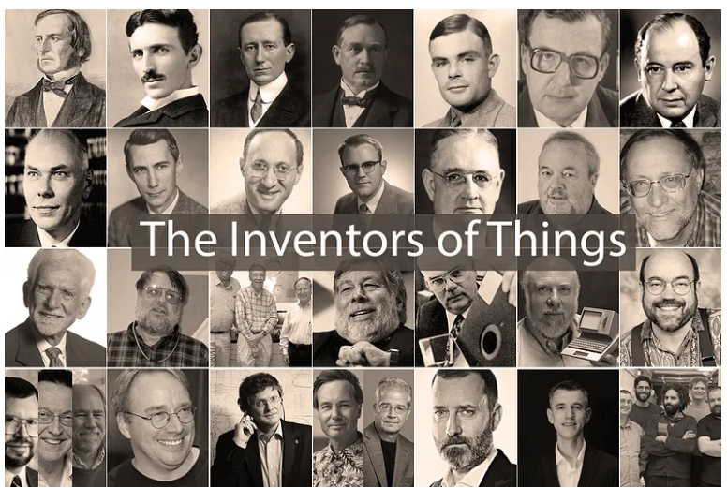
1. Introduction to Internet of Things- HISTORY
Historical Background: The concept of IoT originated in the late 1990s when Kevin Ashton coined the term to describe a system where the internet connects to the physical world via sensors. It gained momentum with advances in wireless communication, cloud computing, and affordable hardware.
Ass. Prof. Kunal D Gaikwad
CSE Department, CMRIT

Slide 8
1. Introduction to Internet of Things- HISTORY
History of IOT:
1970- The actual idea of connected devices was proposed.
1980-first connected device was invented was a coco-cola vending machine operated by programmers.
1990-john romkey -introduces a toaster connected to the internet with TCP/IP protocol.
1995-siemens introduced first cellular module build by M2M
1998-The introduction of IPV6
1999-kevin Asthon introduces the term IOT during his work kevin linked the idea of RFID based item identification system.
2000- LG enables world first internet enabled refrigerators.
2004- BOOK on iot was published and title was famous.
2009- Google starts testing self driving cars.
2013- Google introduced google glass.
2016-first IOT malware named ‘mirai’ was found. key elements of the IOT include.
Ass. Prof. Kunal D Gaikwad
CSE Department, CMRIT

Slide 9
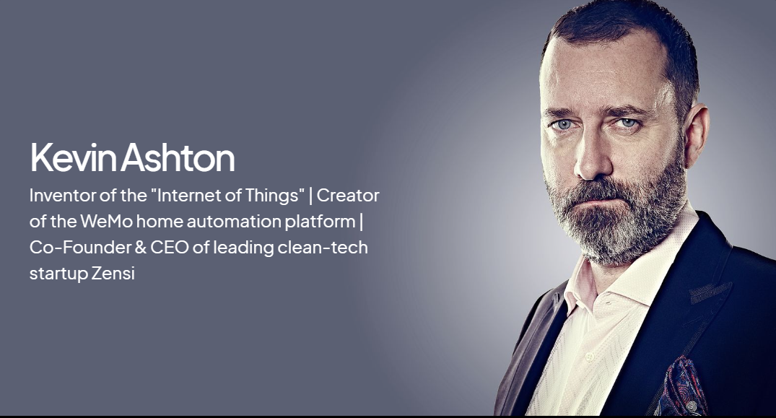
1. Introduction to Internet of Things- HISTORY
Kevin Ashton, co-founder of the Auto-ID Center at the Massachusetts Institute of Technology (MIT), first mentioned the “Internet Of Things” in a presentation he made to Procter &Gamble (P&G) in 1999.
Ass. Prof. Kunal D Gaikwad
CSE Department, CMRIT

Slide 10
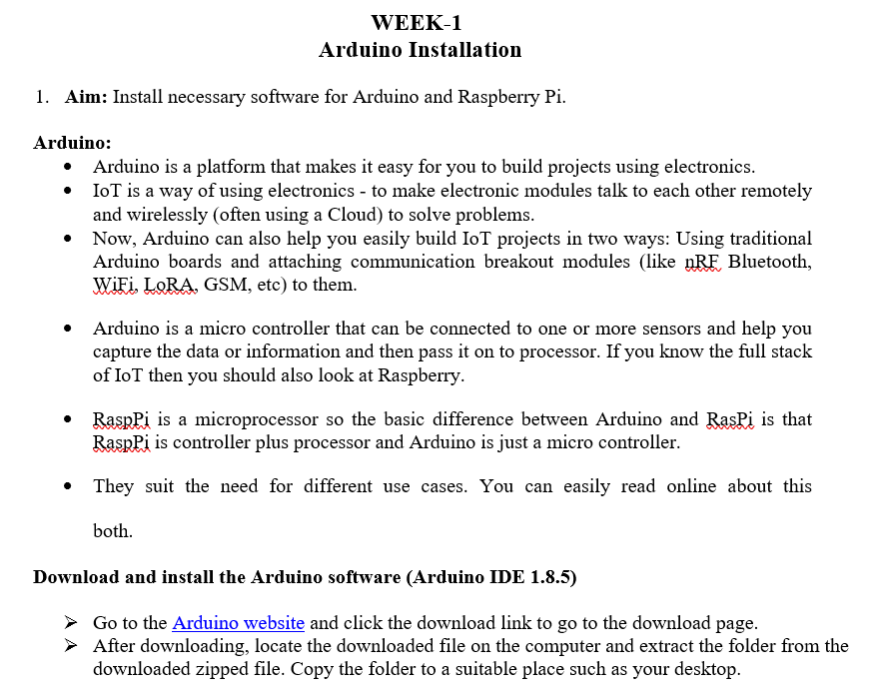
Week 1
Ass. Prof. Kunal D Gaikwad
CSE Department, CMRIT

Slide 11
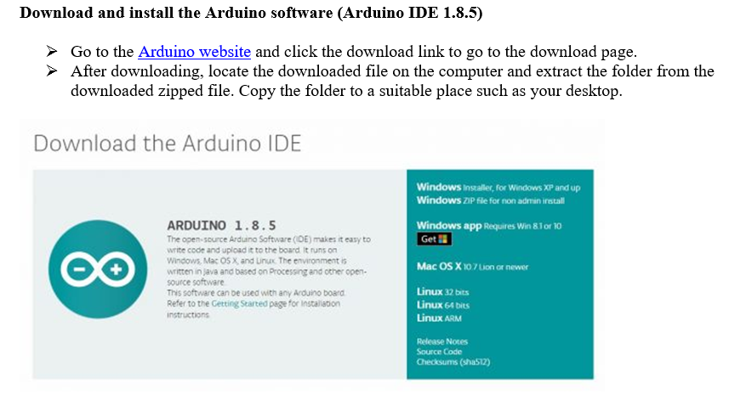
Week 1
Ass. Prof. Kunal D Gaikwad
CSE Department, CMRIT

Slide 12
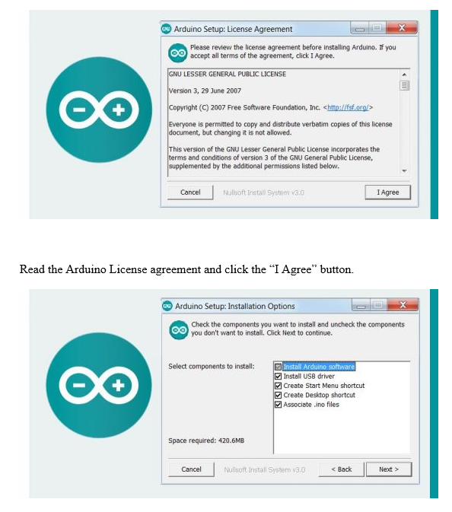
Week 1
Ass. Prof. Kunal D Gaikwad
CSE Department, CMRIT

Slide 13
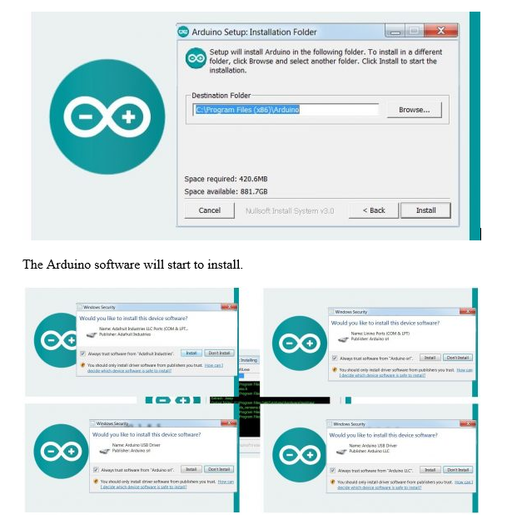
Week 1
Ass. Prof. Kunal D Gaikwad
CSE Department, CMRIT

Slide 14
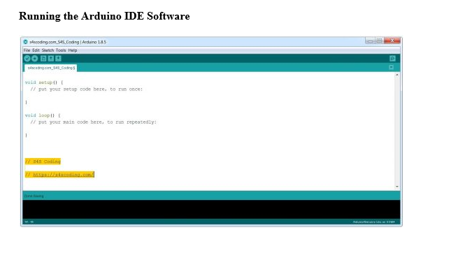
Week 1
Ass. Prof. Kunal D Gaikwad
CSE Department, CMRIT

Slide 15
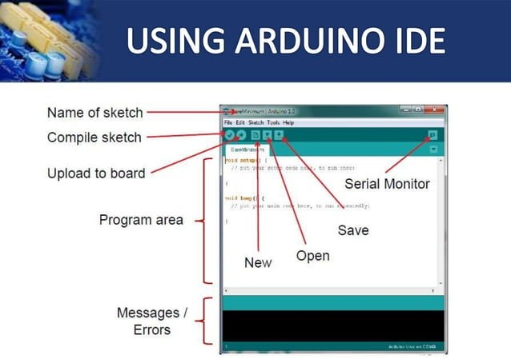
Ass. Prof. Kunal D Gaikwad
CSE Department, CMRIT

Slide 16
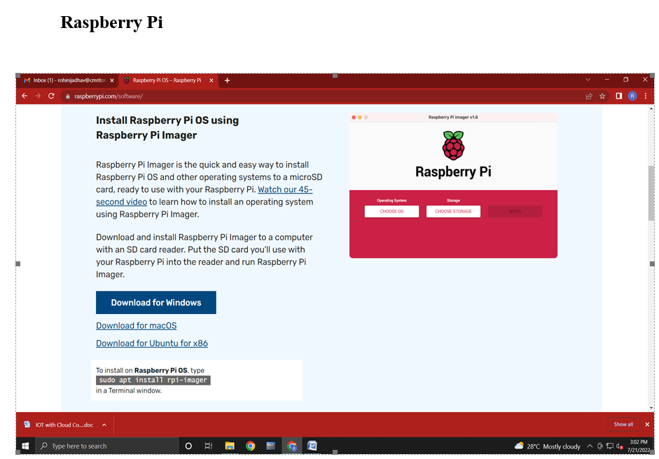
Week 1
Ass. Prof. Kunal D Gaikwad
CSE Department, CMRIT

Slide 17
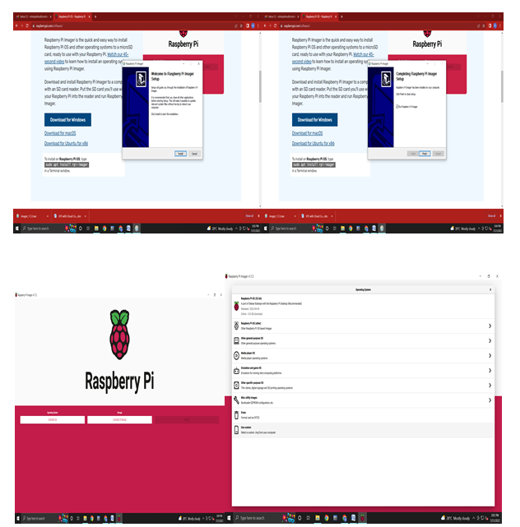
Week 1
Ass. Prof. Kunal D Gaikwad
CSE Department, CMRIT

Slide 18
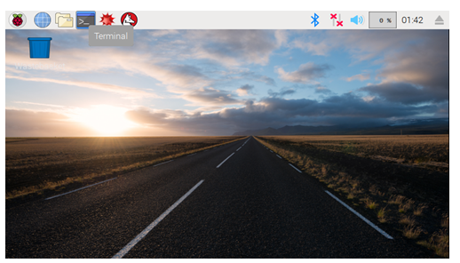
Week 1
Ass. Prof. Kunal D Gaikwad
CSE Department, CMRIT

Slide 19
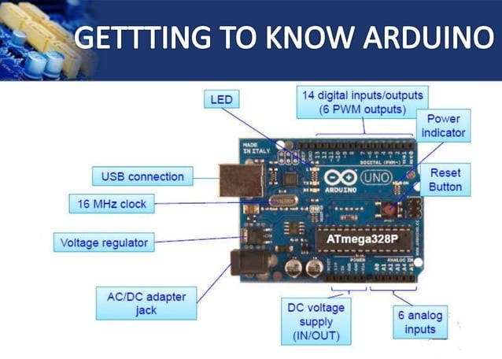
Ass. Prof. Kunal D Gaikwad
CSE Department, CMRIT

Slide 20
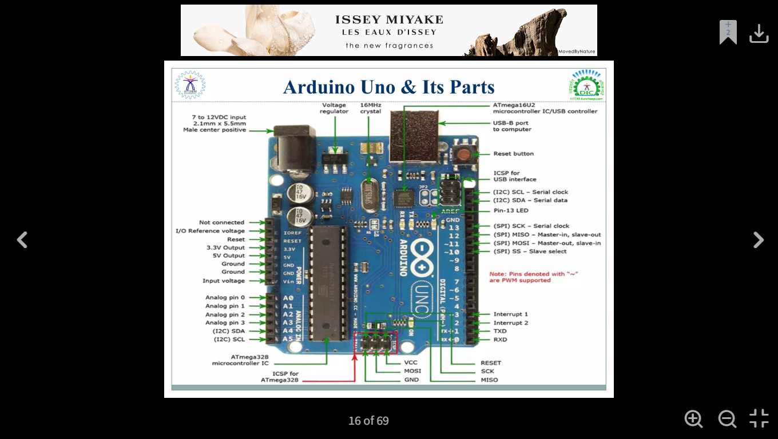
Week 2
The Arduino Uno is a widely used microcontroller board developed by Arduino. It is designed to make electronics and programming accessible for beginners and professionals alike. Here's an overview of the key features and specifications:
Key Features:
Microcontroller: ATmega328P (by Atmel/AVR).
Digital I/O Pins: 14 (of which 6 can be used as PWM outputs).
Analog Input Pins: 6.
Clock Speed: 16 MHz.
Flash Memory: 32 KB (of which 0.5 KB is used by the bootloader).
SRAM: 2 KB.
EEPROM: 1 KB.
Operating Voltage: 5V (input voltage range: 6-20V via barrel jack or 7-12V for optimal operation).
Connectivity: USB-B port for programming and power, as well as UART, SPI, and I2C communication.
Power Supply Options: Can be powered via USB or an external power source.
Ass. Prof. Kunal D Gaikwad
CSE Department, CMRIT

Slide 21
Week 2
Use Cases:
Robotics
IoT projects
Sensors and data acquisition
Home automation
LED and motor control
Advantages:
Beginner-friendly with extensive community support.
Compatible with numerous shields (add-on boards) to extend functionality.
Cross-platform Integrated Development Environment (IDE).
Open-source hardware and software.
Ass. Prof. Kunal D Gaikwad
CSE Department, CMRIT

Slide 22
Week 2
Ass. Prof. Kunal D Gaikwad
CSE Department, CMRIT

Slide 23
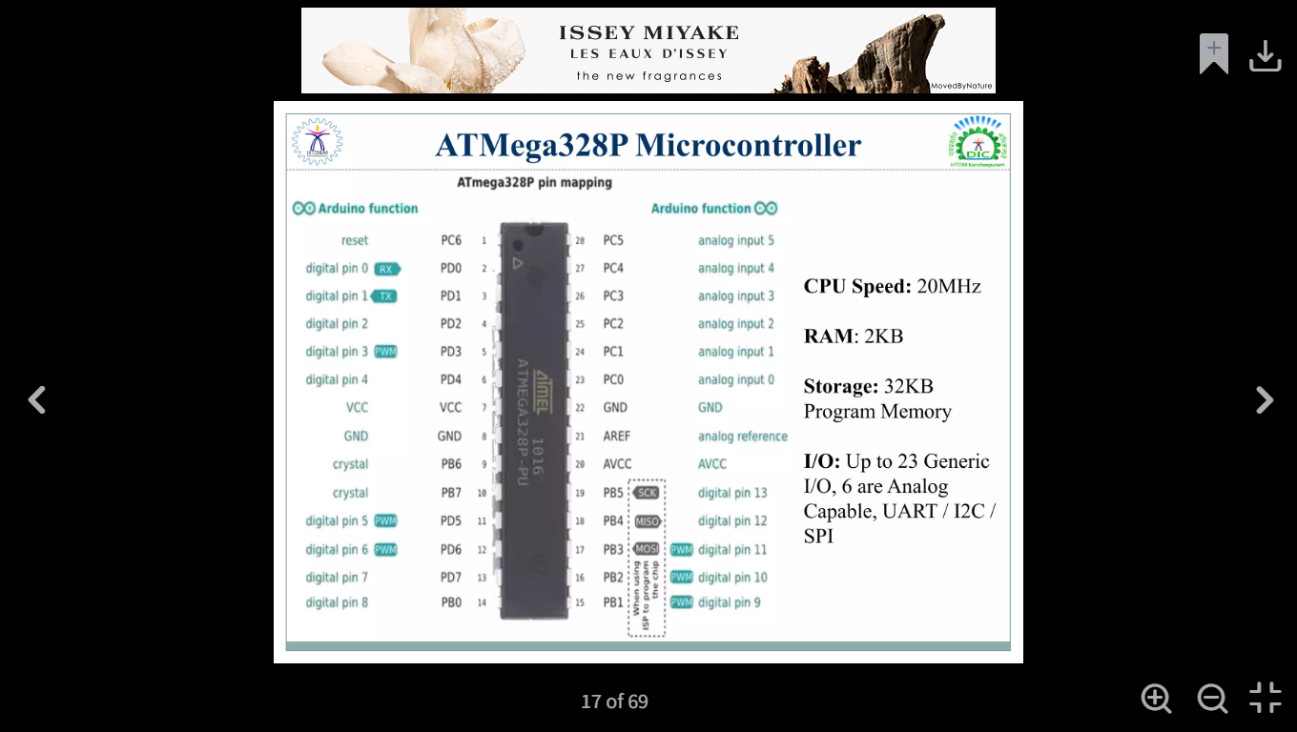
Ass. Prof. Kunal D Gaikwad
CSE Department, CMRIT

Slide 24
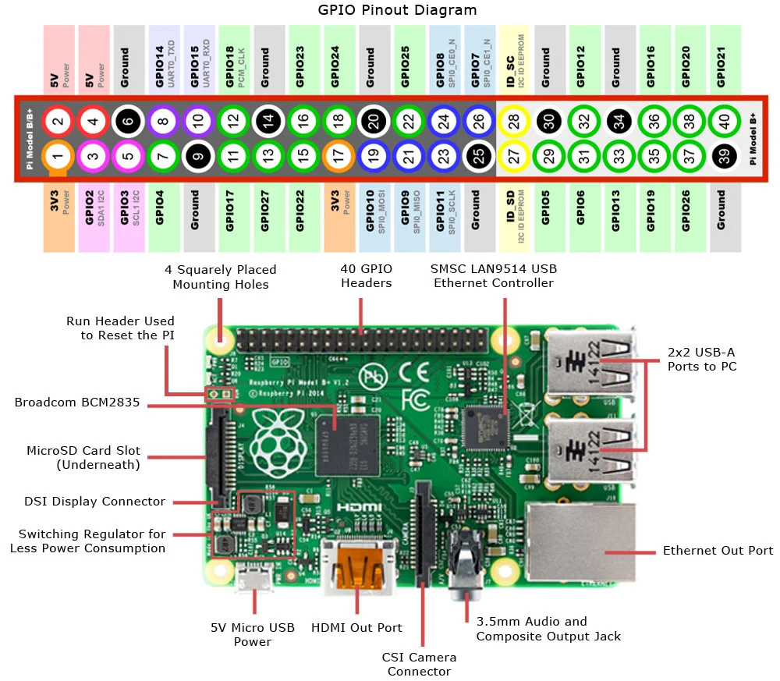
Week 2
Raspberry Pi
board
Ass. Prof. Kunal D Gaikwad
CSE Department, CMRIT

Slide 25
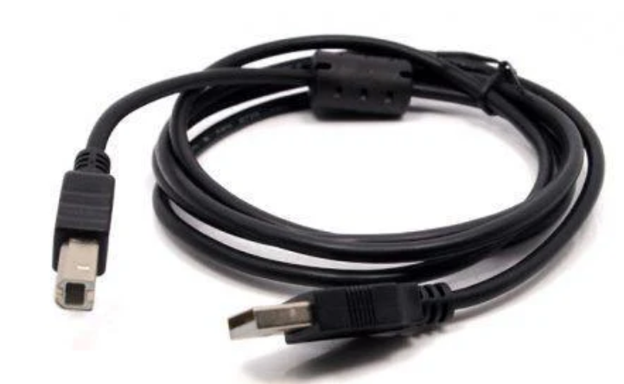
USB 2.0 A-B Cable for Arduino and Home Printers (1.2 meters)
Ass. Prof. Kunal D Gaikwad
CSE Department, CMRIT

Slide 26
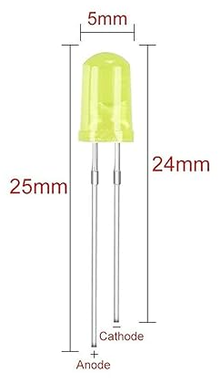
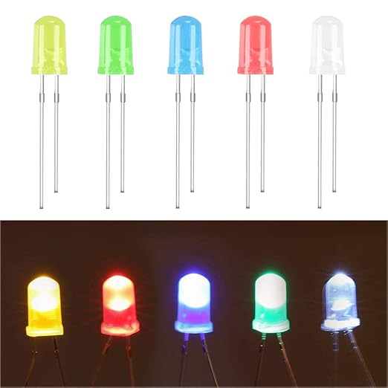
5mm LED Light Diodes
Ass. Prof. Kunal D Gaikwad
CSE Department, CMRIT

Slide 27
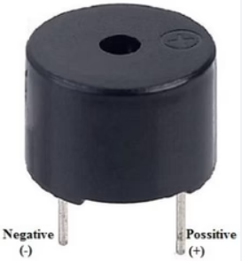
Buzzer
Ass. Prof. Kunal D Gaikwad
CSE Department, CMRIT

Slide 28
led Blink and Buzzer
void setup() {
// initialize digital pin LED_BUILTIN as an output.
pinMode(LED_BUILTIN, OUTPUT);
}
// the loop function runs over and over again forever
void loop() {
digitalWrite(LED_BUILTIN, HIGH); // turn the LED on (HIGH is the voltage level)
delay(1000); // wait for a second
digitalWrite(LED_BUILTIN, LOW); // turn the LED off by making the voltage LOW
delay(1000); // wait for a second
}
Ass. Prof. Kunal D Gaikwad
CSE Department, CMRIT

Slide 29
// Define the pin numbers for the RGB LED
int redPin = 9;
int greenPin = 10;
int bluePin = 11;
void setup() {
// Set the RGB LED pins as OUTPUT
pinMode(redPin, OUTPUT);
pinMode(greenPin, OUTPUT);
pinMode(bluePin, OUTPUT);
}
void loop() {
// Red color
digitalWrite(redPin, HIGH);
digitalWrite(greenPin, LOW);
digitalWrite(bluePin, LOW);
delay(1000); // Wait for 1 second
// Green color
digitalWrite(redPin, LOW);
digitalWrite(greenPin, HIGH);
digitalWrite(bluePin, LOW);
delay(1000); // Wait for 1 second
// Blue color
digitalWrite(redPin, LOW);
digitalWrite(greenPin, LOW);
digitalWrite(bluePin, HIGH);
delay(1000); // Wait for 1 second
// All colors off
digitalWrite(redPin, LOW);
digitalWrite(greenPin, LOW);
digitalWrite(bluePin, LOW);
delay(1000); // Wait for 1 second
}
Ass. Prof. Kunal D Gaikwad
CSE Department, CMRIT

Slide 30
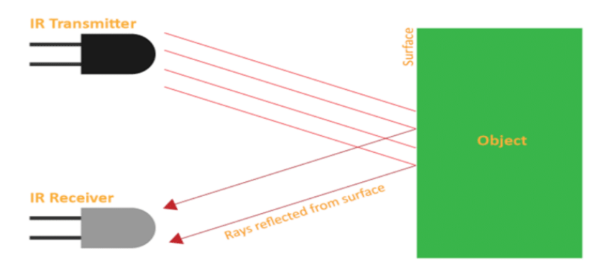
An IR (Infrared) sensor in IoT (Internet of Things) is a device that uses infrared light to detect objects, measure distances, or sense heat emitted by an object.
It plays a crucial role in IoT applications like:
Motion detection: Used in smart home security systems to detect movement.
Proximity sensing: Detects objects in close range, such as in automatic doors.
Environmental monitoring: Measures heat levels for applications like smart thermostats or industrial safety.
Remote control: Enables communication between devices using IR signals.
It is energy-efficient, cost-effective, and widely used in IoT devices for automation and monitoring tasks.
IR Sensor
Ass. Prof. Kunal D Gaikwad
CSE Department, CMRIT

Slide 31
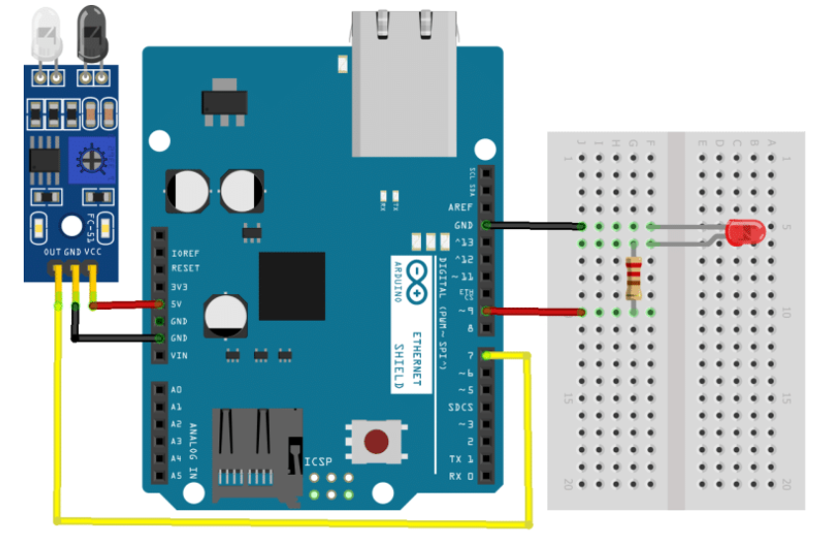
IR Sensor
Ass. Prof. Kunal D Gaikwad
CSE Department, CMRIT

Slide 32
IR sensor
int IRPin =2;
int led=13;
int value;
void setup(){
pinMode(IRPin,INPUT);
Serial.begin(9600);
pinMode(led,OUTPUT);
}
void loop(){
value = digitalRead(IRPin);
Serial.println(value);
if(digitalRead(IRPin)==0)
{
digitalWrite(led,HIGH);
Serial.println("object detected");
}
else
{
digitalWrite(led,LOW);
Serial.println("object not detected");
}
}
Ass. Prof. Kunal D Gaikwad
CSE Department, CMRIT

Slide 33
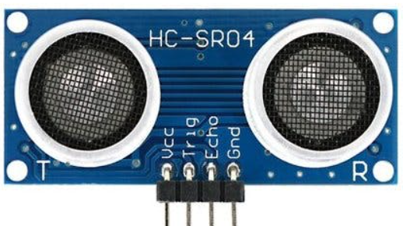
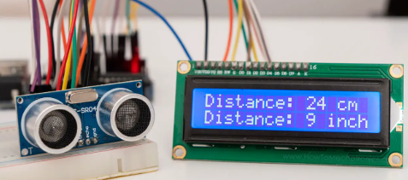
An ultrasonic sensor in IoT is a device that uses ultrasonic sound waves (high-frequency sound beyond human hearing) to measure distance, detect objects, or monitor levels. It works by emitting sound waves and measuring the time it takes for the echo to return.
Key IoT applications include:
Proximity detection: Used in obstacle detection for robotics or autonomous vehicles.
Distance measurement: Measures distance in applications like parking sensors or smart water level monitoring.
Smart agriculture: Monitors soil levels or tank water levels.
Security systems: Detects intrusions in restricted areas.
Ultrasonic sensors are accurate, non-contact, and versatile, making them ideal for IoT automation and sensing tasks.
Ultrasonic Sensor
Ass. Prof. Kunal D Gaikwad
CSE Department, CMRIT

Slide 34
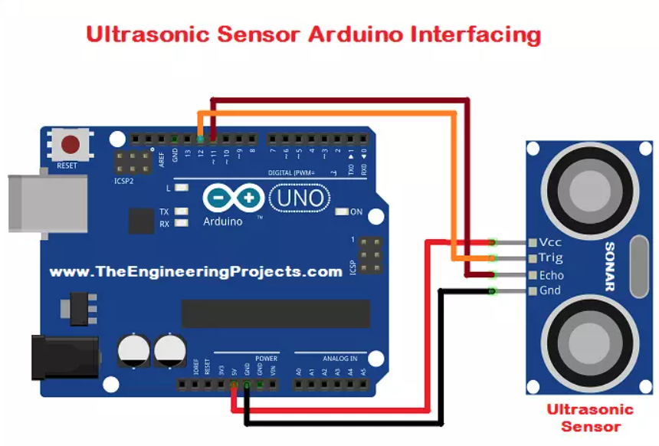
Ultrasonic Sensor
Ass. Prof. Kunal D Gaikwad
CSE Department, CMRIT

Slide 35
Ultrasonic
#define ECHOPIN 7 // Pin to receive echo pulse
#define TRIGPIN 8
int led=12;
int a,b;
void setup()
{
Serial.begin(9600);
pinMode(ECHOPIN, INPUT);
pinMode(TRIGPIN, OUTPUT);
pinMode(led,OUTPUT);
}
void loop()
{
digitalWrite(TRIGPIN, LOW);
delayMicroseconds(2000);
digitalWrite(TRIGPIN, HIGH);
delayMicroseconds(1000);
digitalWrite(TRIGPIN, LOW);
float a = pulseIn(ECHOPIN, HIGH);
digitalWrite(led,HIGH);
b= a*0.0344/2;
Serial.print(b);
Serial.println(" cm");
delay(3000);
}
Ass. Prof. Kunal D Gaikwad
CSE Department, CMRIT

